Slide 1
YOUTUBE TRANSCRIPTTER
Nimmalapudi. Durga Sahithi

Slide 2


Agenda
A
Introduction
Primary goal
Abstract
Project statement
GUI of this project
Output

Slide 3
Introduction
YouTube is a video sharing platform, the second- most visited website, the second most used search engine, and is stronger than ever after more than 17 years of being online. YouTube uploads about 720,000 hours of fresh video content per day. The number of videos available on the web platform is steadily growing. The most important part of this project will be its ability to string together all the necessary information and concentrate it into a small paragraph. Video summarization is the process of identifying the significant segments of the video and produce output video whose content represents the entire input video

Slide 4
Primary goals
To reducing the storage space used for the video.

Slide 5
ABSTRACT
video transcript summarizer has got a lot of scope in today's world. it highlights the important topics from the video people spend a noticeable amount of time binge watching youtube videos, be it for entertainment, education purposes, or getting some important information or exploring their interests. if you wish to find a video to get any important information about a topic, it is a very difficult task to achieve as most of the videos are filled with insignificant buffer material. in most of the cases, the overall intent is to obtain some form of quality information from the video. this project brings forward a video summarization system based on natural language processing and machine learning to generalize youtube video transcripts for abstractive text summarization without losing the main elements and content. this project focuses on to reducing the length of the script for the videos.
Keywords:- Natural Language Processing, Machine Learning, Abstractive Text Summarization

Slide 6
Problem statement
The issue with the content on YouTube is that there’s a lot of it.
The downside of this is that it gives rise to incessant clickbait videos, which end up wasting the time of the user.
A quick glance at the summary would let the user know whether the video is worth their time and if it contains the topics that they would be looking for. It can also be used to quickly recapitulate useful information in the video.

Slide 7
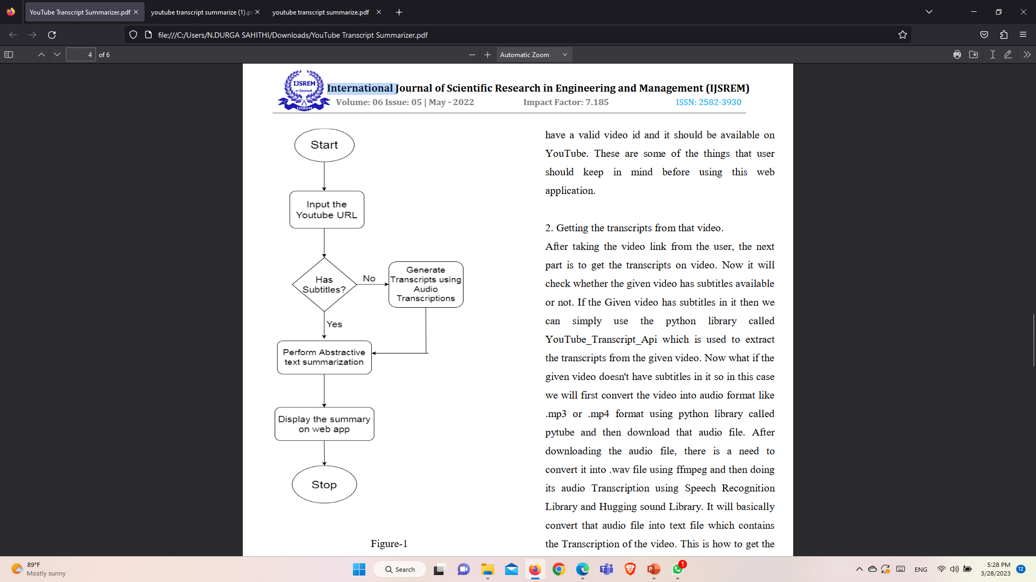
GUI

Slide 8
Areas of focus
F
python
[ libraries like Flask,YouTube transcript v api,Hugging-face libraries ofTransformers, Speechrecognitionapi, google translate api, Pytube , ffmpeg and many more whichcan be used in many real world applications.]
Database
Front end for basic HTML

Slide 9
Summary
Recently, video summarization has attracted considerable interest from researchers and as a result, various algorithms and techniques have been proposed.This project is to provide a web app or a chrome extension that can be used tosummarize the YouTube video content and extract important information from those patterns by using state-of- the-art Natural Language Processing methods for abstractive text summarization and Machine Learning for classification.

Slide 10
Thank you
Done by:
Nimmalapudi .Durga Sahithi.
From :
Dr. B. R. Ambedkar university
Srikakulam.
Guided by:
Umamaheshwari.
From :
Edunet Foundation

